Slide 1
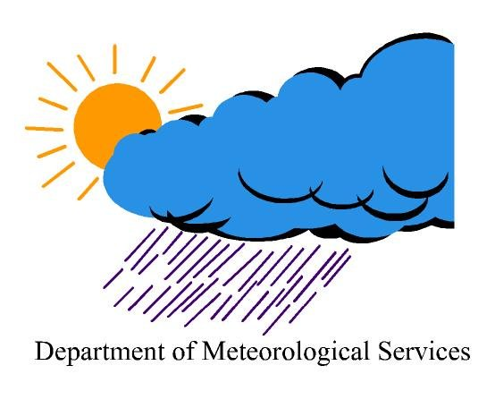
Public Weather and Warning Services By: Charles Masule Molongwane Head, Numerical Weather Division Unit Botswana Department of Meteorological Services P O Box 10100, Gaborone, Botswana 16th November 2015 Tel/Fax: +267 3612296; +267 3956282 Email: cmolongwane@gov.bw
Republic of Botswana
Our Vision: A modern weather service that nurtures and harbours innovation and creativity in the provision of quality weather and climate information.

Slide 2
Relationship with Disaster Managers
Draft memorandum of Understanding MoU and SOP
Our Vision: A modern weather service that nurtures and harbours innovation and creativity in the provision of quality weather and climate information.

Slide 3
Dissemination Methods
E-mail-Distribution list-Five days forecast
Social Media- Facebook
Press Releases-Heat Waves , Seasonal Forecasts
Common Alerting Protocol-WMO standard initiative
Radio Botswana, Masa-a-sele (weekdays), Tsele-le- Tsele (Fridays) and other Private Stations (Gabz, Duma and Yarona FM)
Television
Our Vision: A modern weather service that nurtures and harbours innovation and creativity in the provision of quality weather and climate information.

Slide 4
Challenges with Working with Disaster Authorities and Media
NDMO - Under office of President- Political influence
NDMO - Staff Shortage
Media - Profit Oriented- Failed CAP implementation
Media- Request of prompt either Radio or Television Interviews
Media- Bad interpretation of Meteorological Information
Our Vision: A modern weather service that nurtures and harbours innovation and creativity in the provision of quality weather and climate information.
16/11/2015

Slide 5
FEEDBACK
NDMO- through MOU agreement to avail complied districts disaster report about forecast severe weather from BDMS
Questionnaire done by Staff as part of Annual Performance Development Developments (Objectives).
Live Radio and Television interview
16/11/2015

